Slide 1
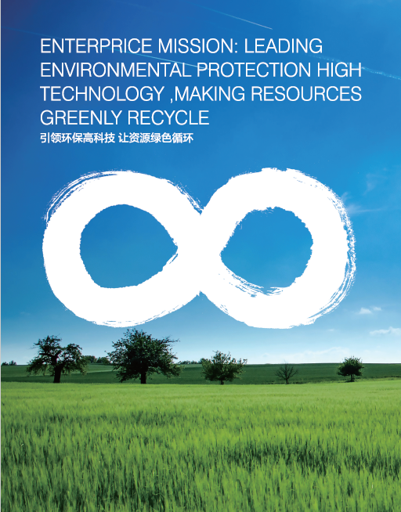
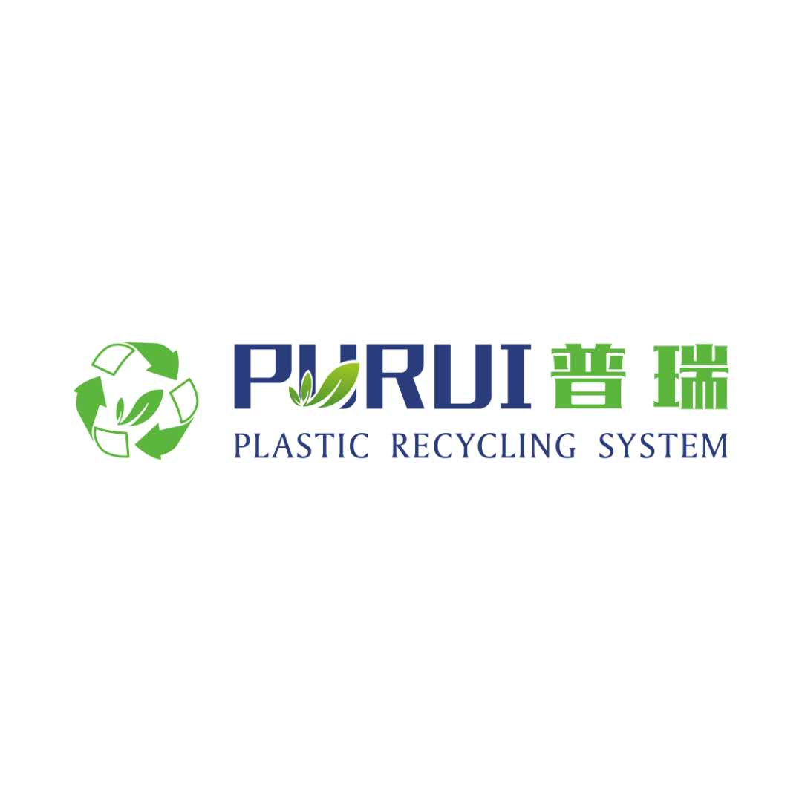
CHENGDU PURUI POLYMER ENGINEERING CO., LTD
做资源循环与环境保护领域技术装备的创新者
BE THE INNOVATOR OF RESOURCES RECYCLE AND ENVIRONMENTAL PROTECTION FIELD
创新
精进
诚信
共赢

Slide 2
Profile
PURUI group has been in the field of plastic recycling, and the waste battery recycling, such as the waste lithium-ion batteries, lead acid battery recycling. Estalished in 2006, we started from manufacturing and research on the plastic pelletizing machines, expanded to the all kinds of plastic(waste electrical and electronic, post indutrial plastic waste, post customer plastic waste, and the lithum battry etc) recycling line including the crushing sorting washing machine etc.
Our Lithium battery and lead acid recycling plant locats in Hunan province. We worked with zhongnan university and with 5 patents, 2 invention patents. We will offer the advanced technology for the lithium battery recycling. In China we have 5 lines of the lithium battery recycling.

Slide 3
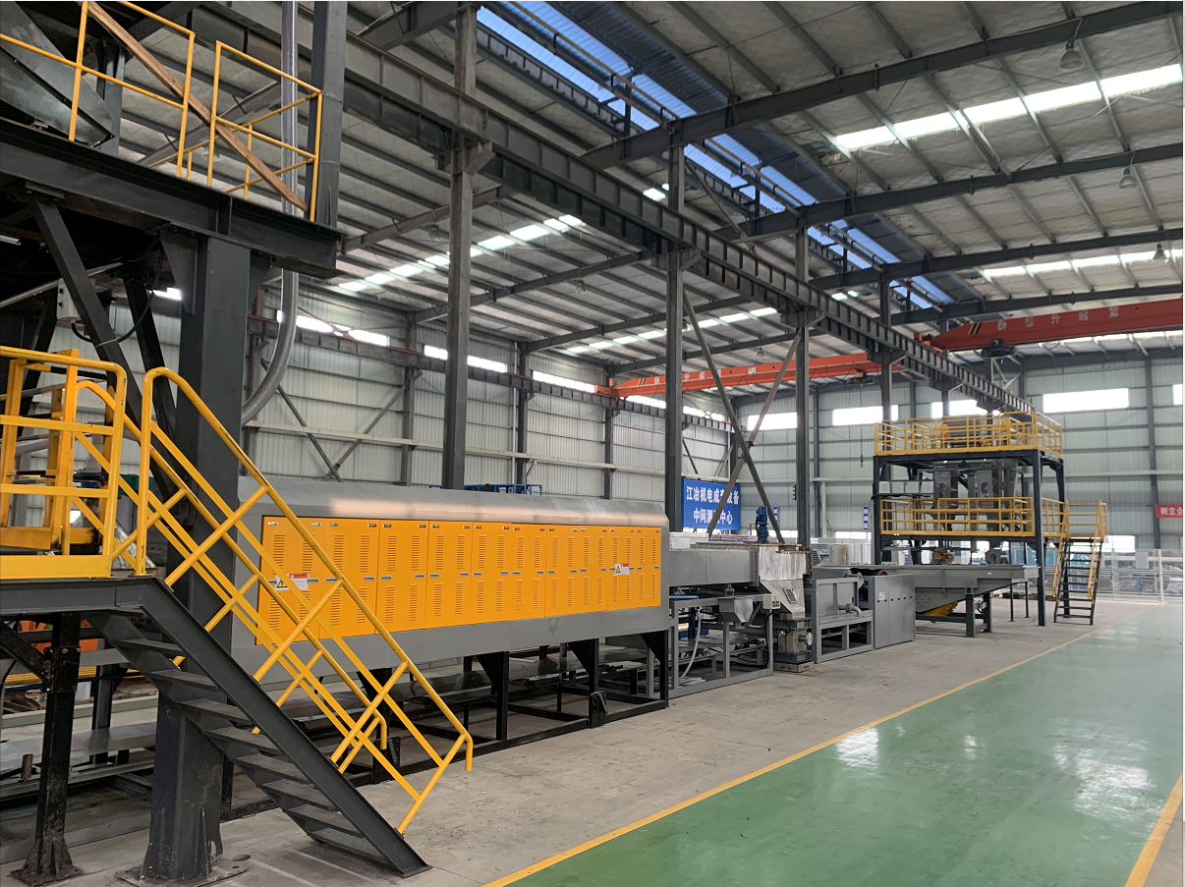
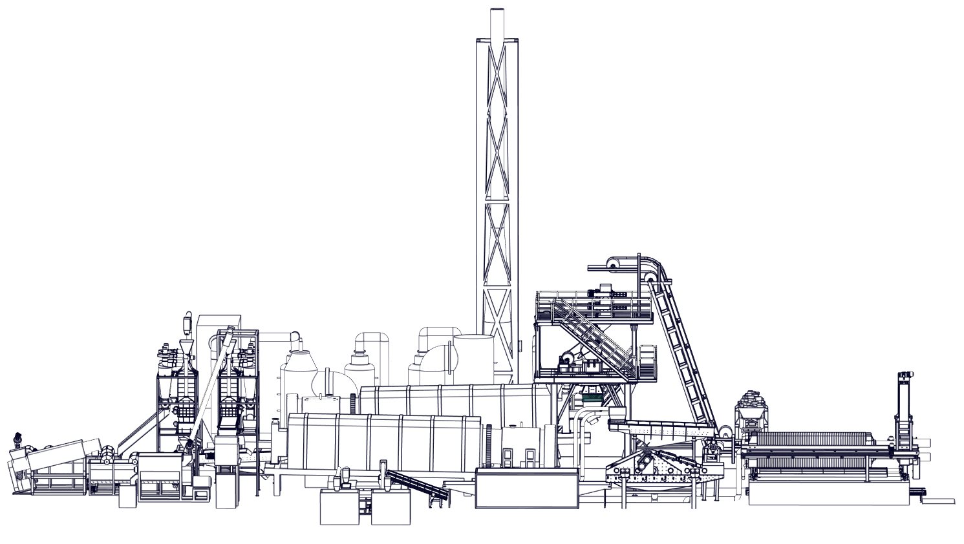
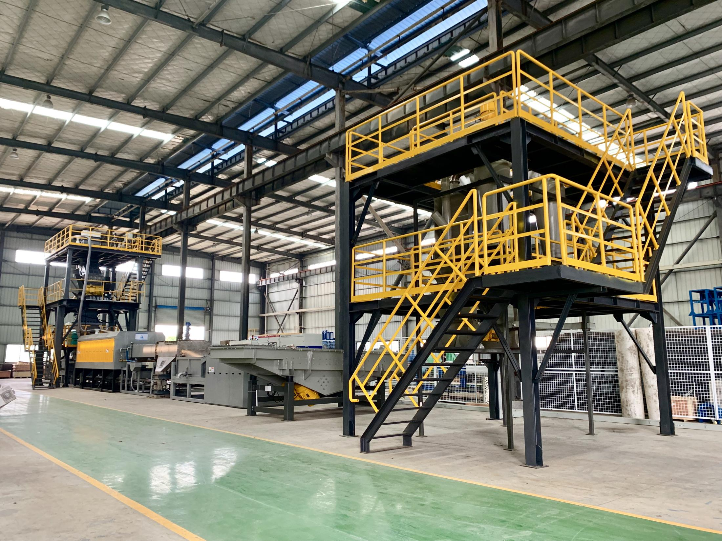
Complete set of equipment for crushing and sorting waste lithium-ion batteries
"Waste lithium ion crushing and sorting equipment and technology" has established an industrial demonstration line with an annual processing capacity of 5000t/a. Considering the large process of lithium battery recovery, aiming at resource regeneration and maximization of benefits, "charged crushing - electrolyte pretreatment - high temperature pyrolysis - full-component physical separation process" is adopted to effectively solve the problem of long discharge cycle of brine, Electrolyte water pollution, easy short-circuit discharge during crushing, incomplete stripping of positive and negative powder, high content of copper scraps and aluminum scraps in electrode powder, fluoride pollution and other technical problems in the industry. The separator, pile head shell, copper foil, aluminum foil, positive and negative electrode powder in the waste lithium-ion battery are recycled safely, environmentally friendly and efficient, and the recycling of resources is realized. The recovery rate of pole powder is ≥96% and the grade is ≥98%. Through online oxygen content + temperature detection + video monitoring, PLC plus position computer centralized chain control.

Slide 4
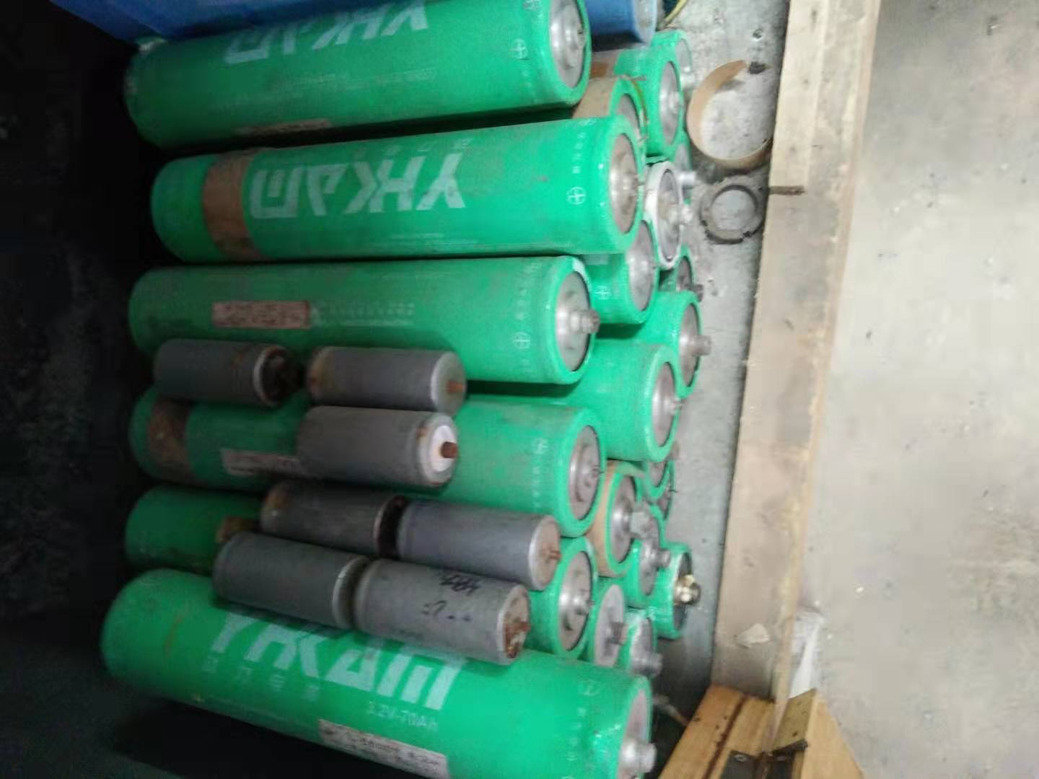
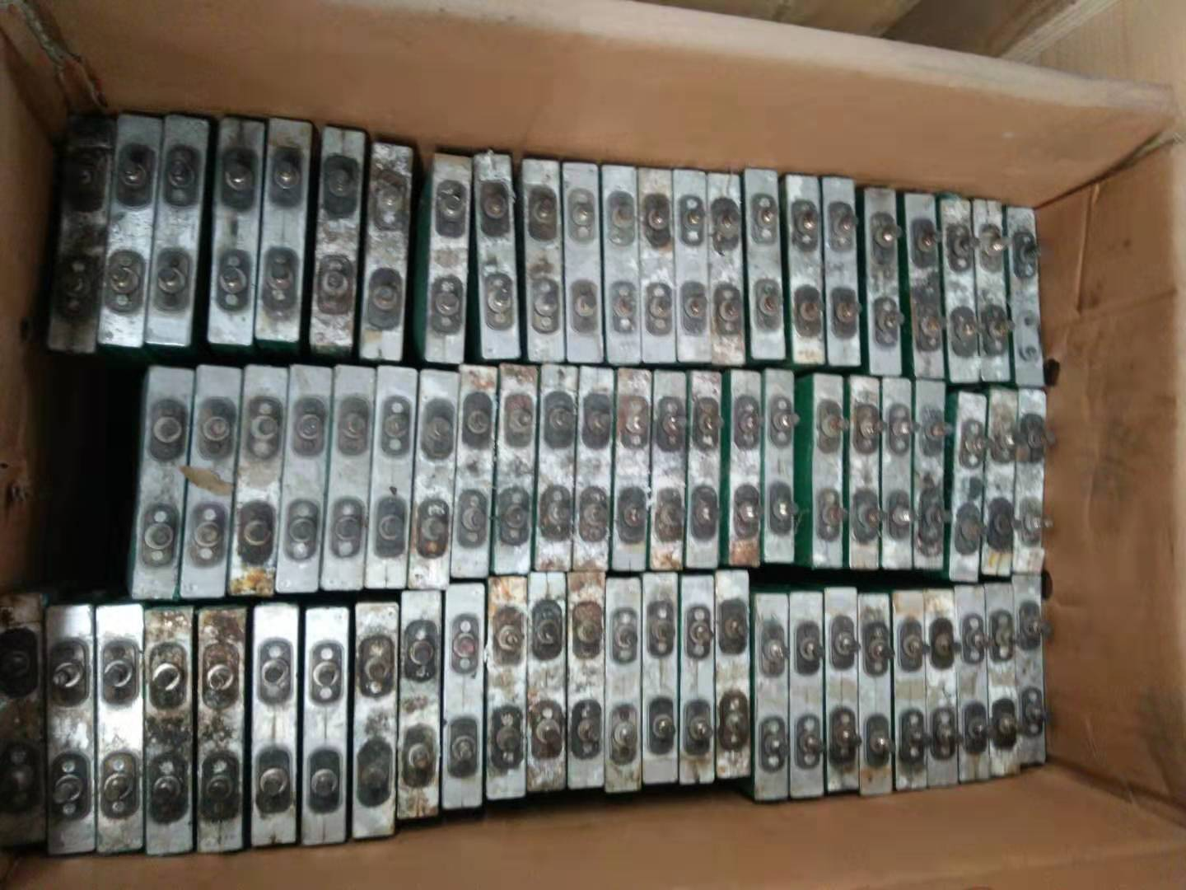
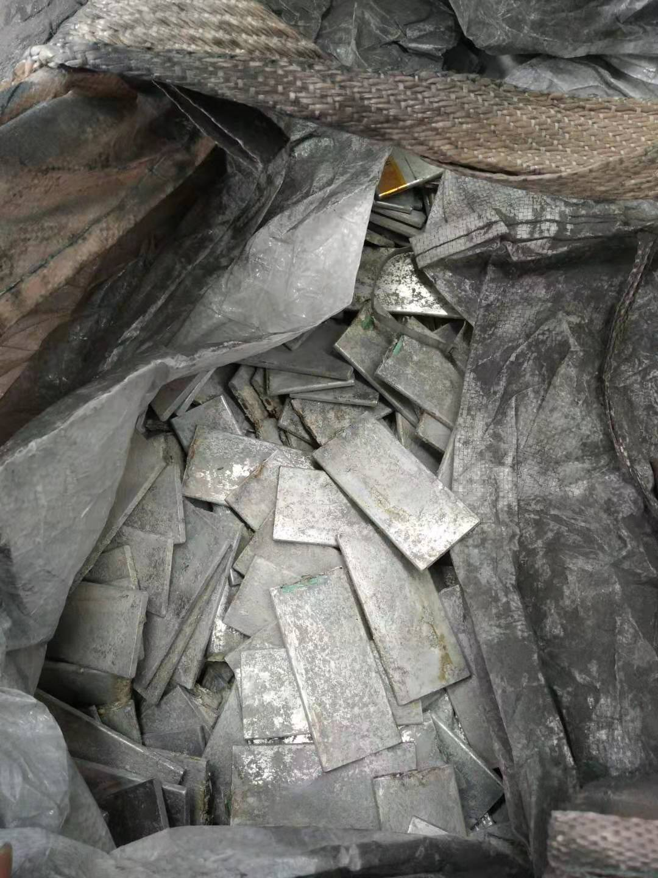
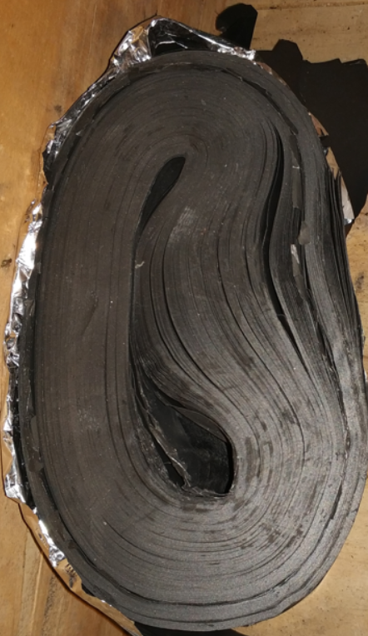
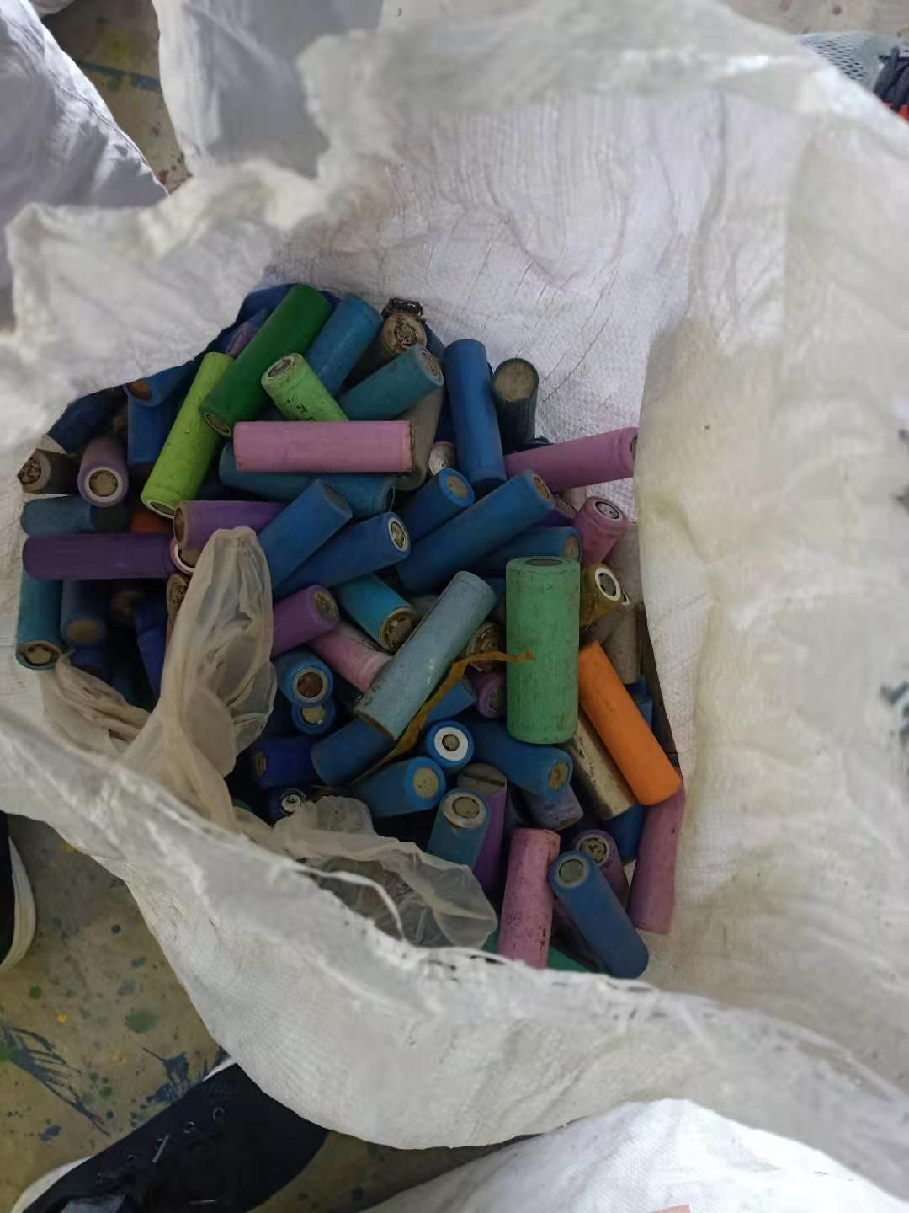
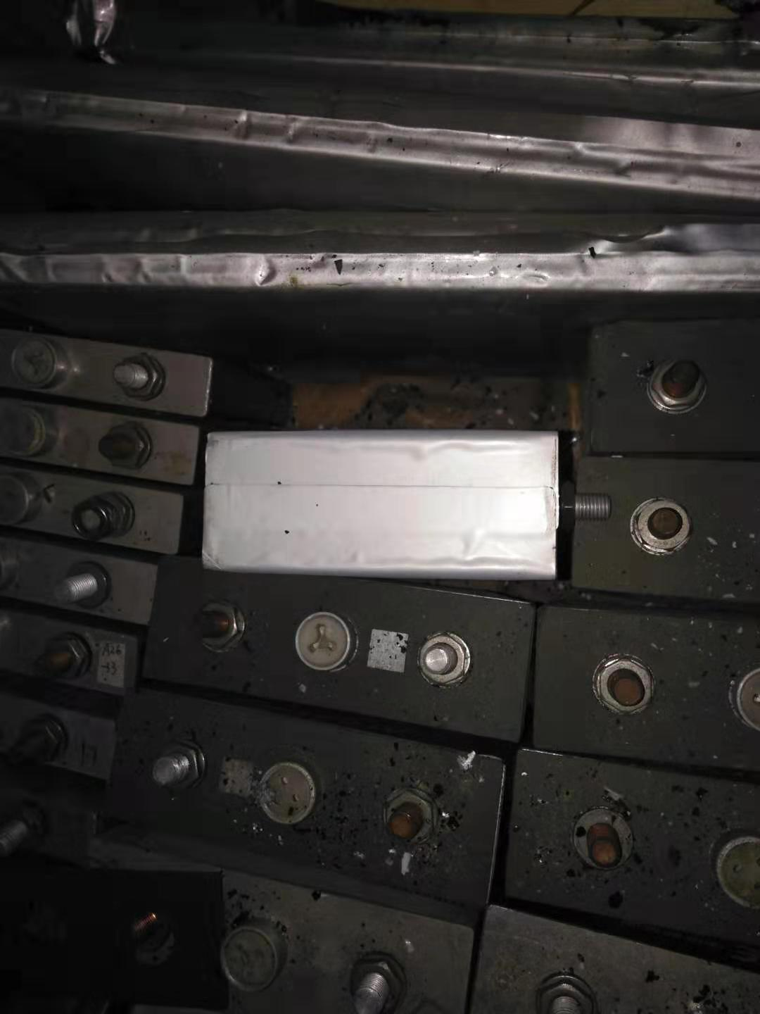
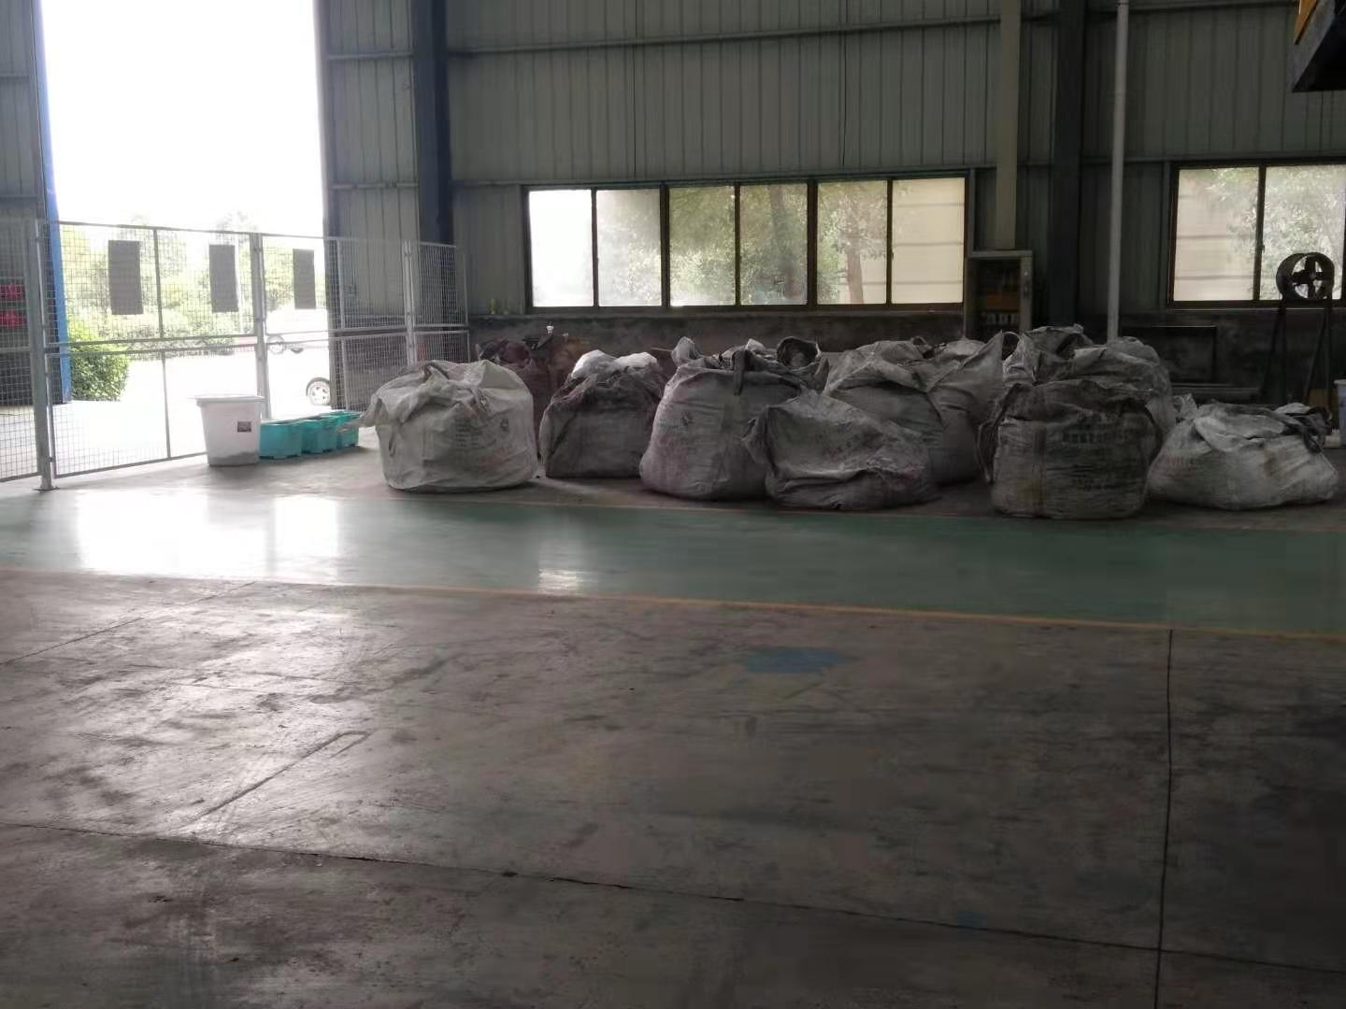
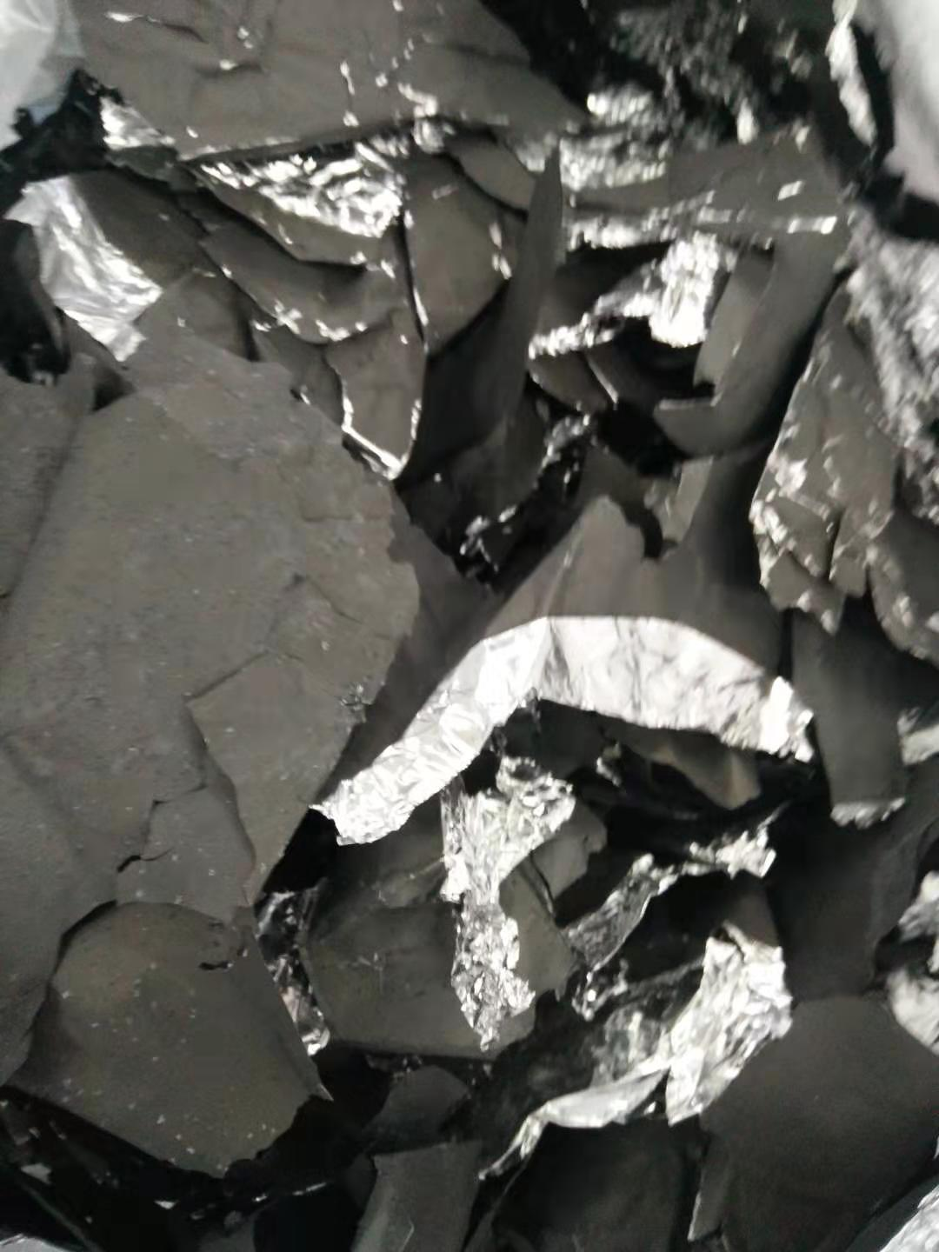
Types of waste lithium battery raw materials
LiFePO4 raw materials
LiNi0.3Co0.3Mn0.3O2 battery
3C battery raw materials
pole piece edge material

Slide 5
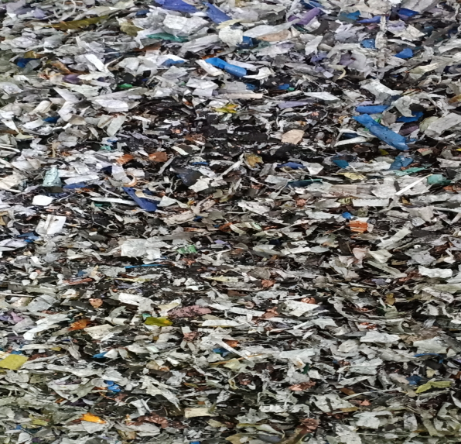
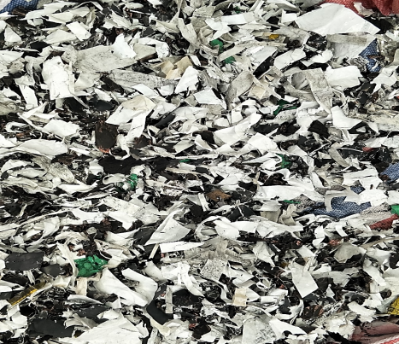
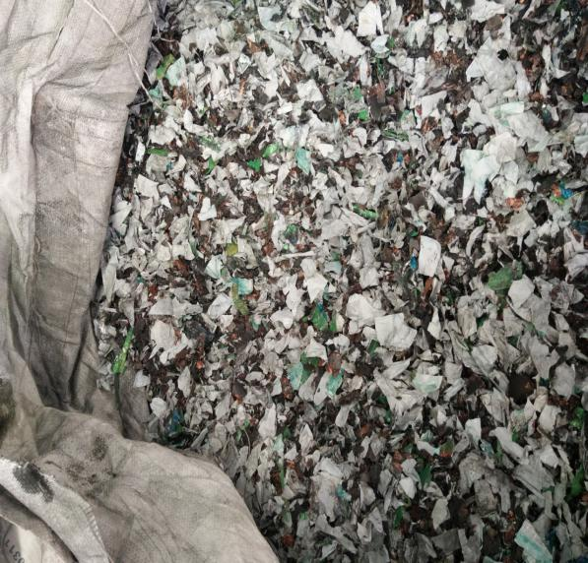
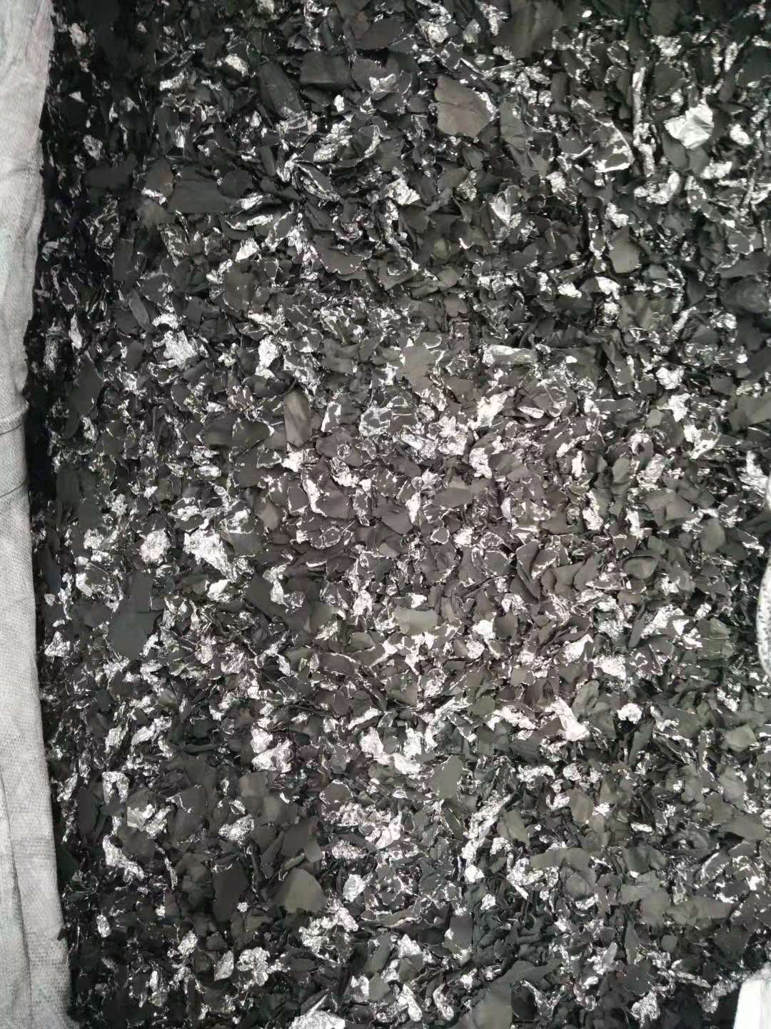
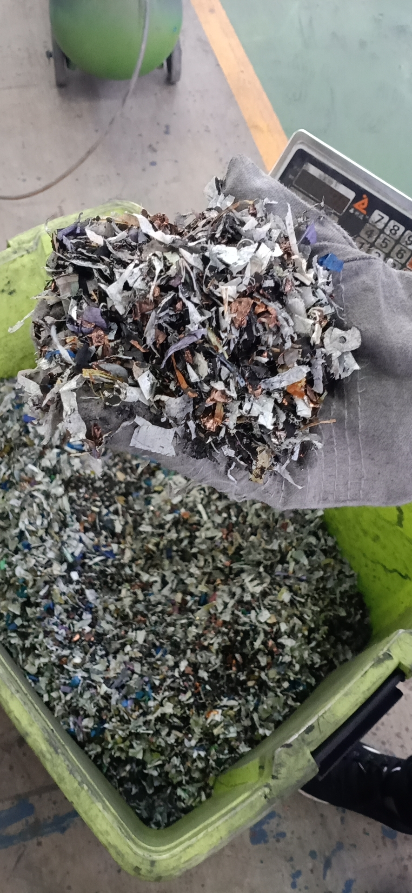
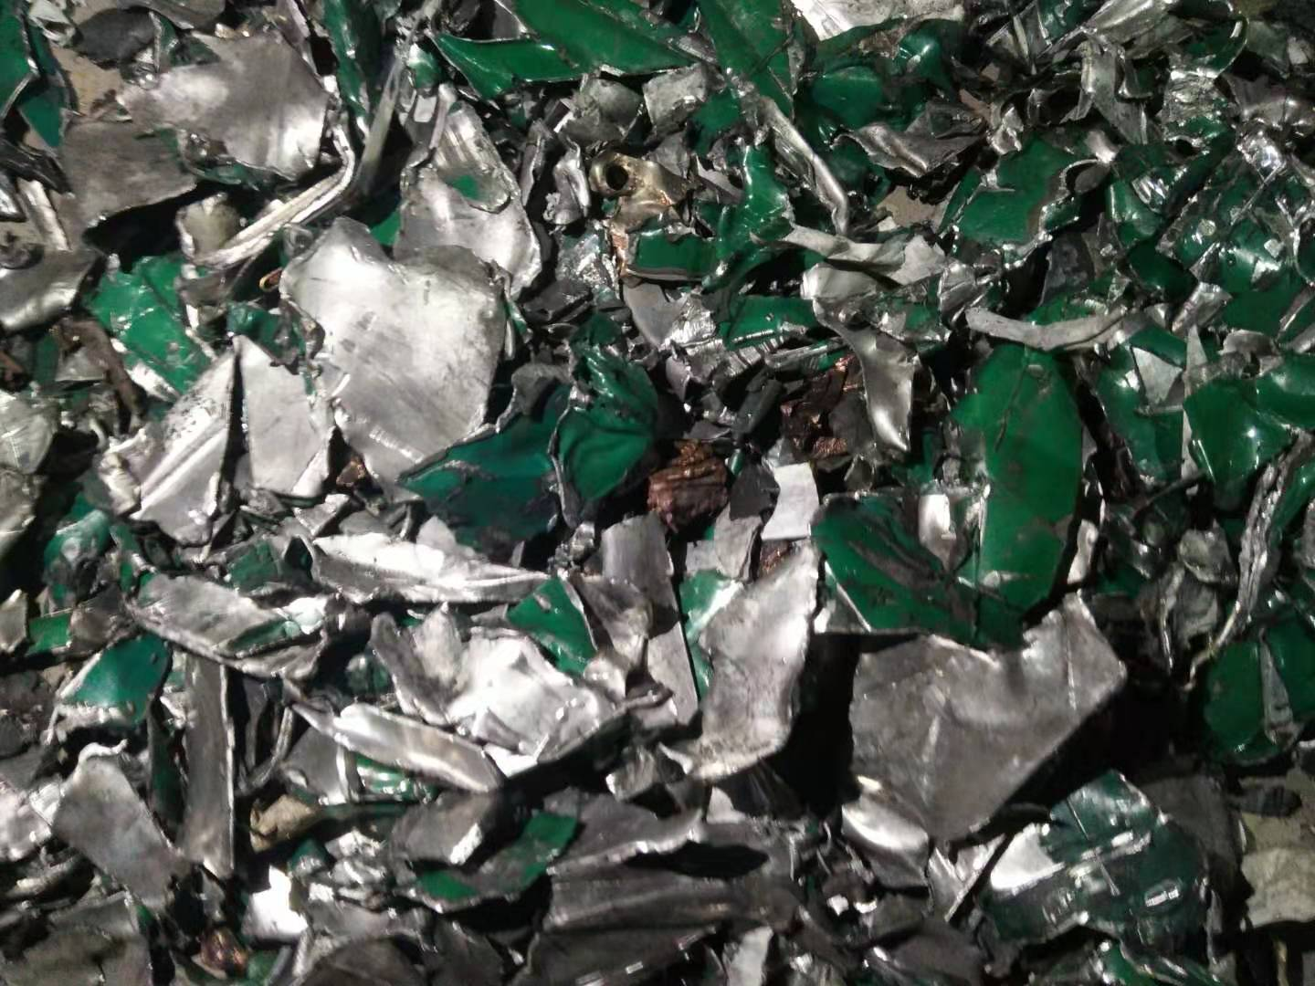
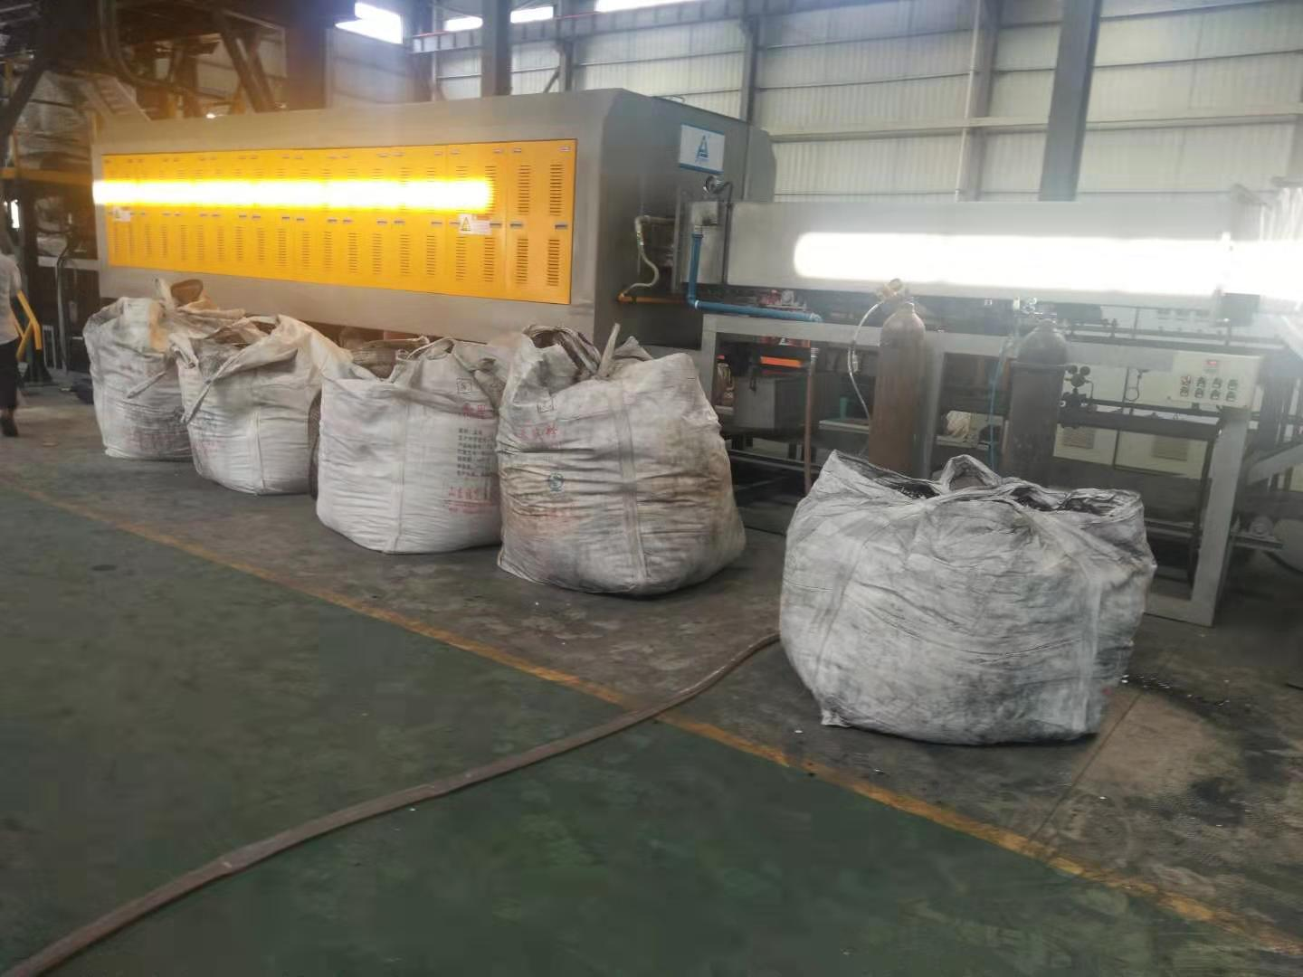
Waste lithium battery crushing material
LiFePO4 battery crushing material
LiNi0.3Co0.3Mn0.3O2. battery crushed material
3C battery crushed material
Pole piece corner crushing material

Slide 6
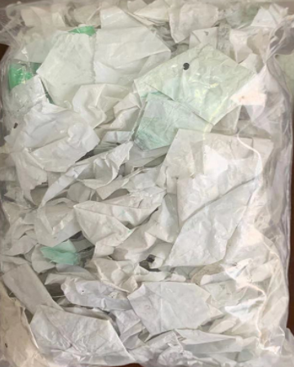
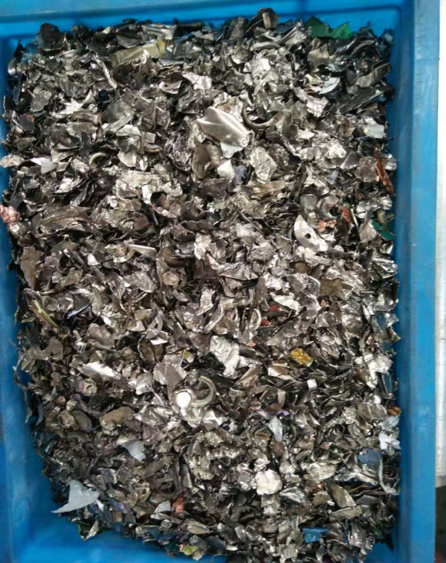
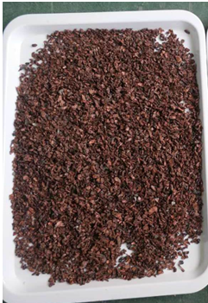
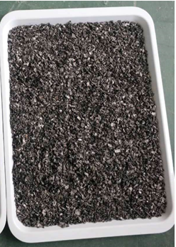
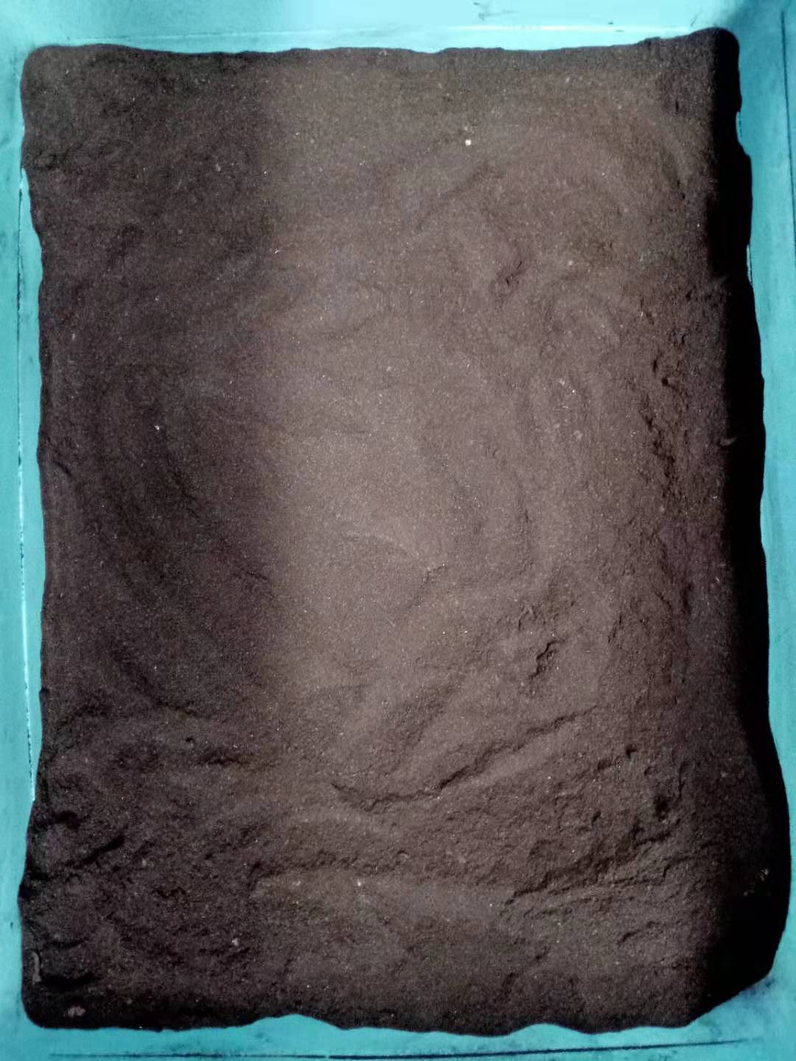
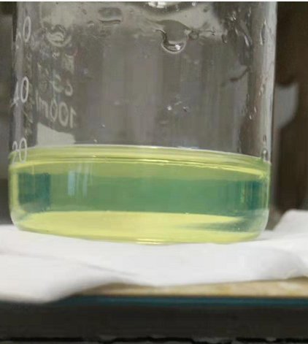
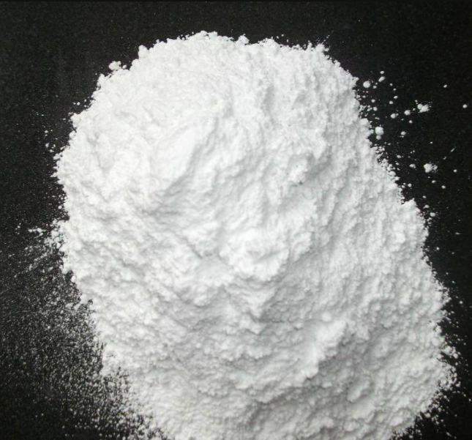
Fully Recycling Raw Material
Septum
Pile head, shell
copper foil
aluminum foil
Cathode and anode powder
Electrolyte
calcium fluoride

